Slide 1
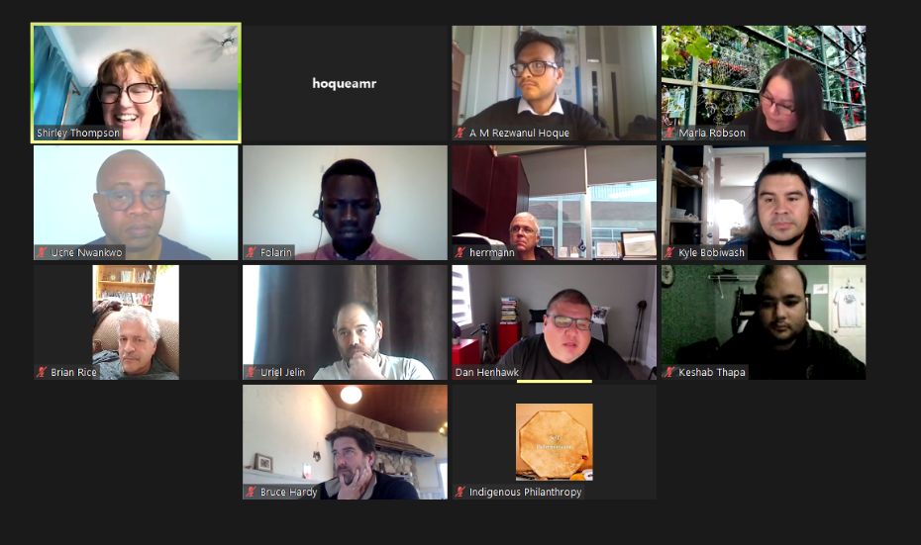

Kitigay
Indigenous Food Systems Team

Slide 2
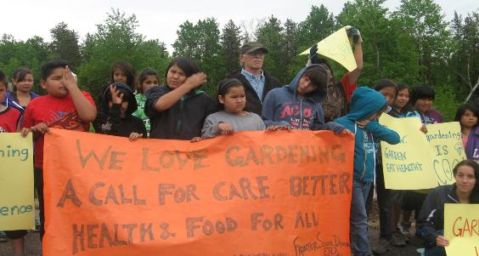
Kitigay
“Kitigay“ is an Anishinaabe word meaning to plant. Kitigay describes the hope for this post-secondary education.
This Kitigay program is to grow plants but also ideas of reconciliation, Indigenous food sovereignty, Indigenous student capacity and food businesses.

Slide 3
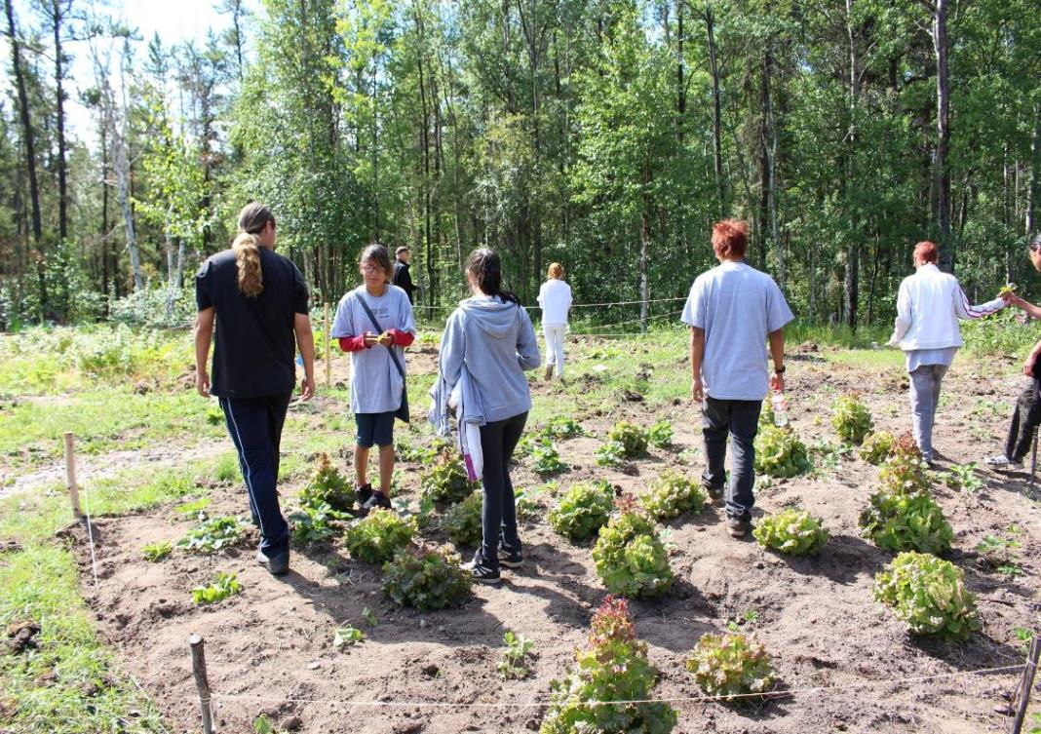
Kitigay Vision
Post-secondary education, if community-led and projects-based, has the potential to transform education and food policy, as well as build capacity locally.
will leapfrog from colonially imposed to self-determined and community-led education through partnerships between community and university.
The University of Manitoba (UM) option to pilot Kitigay courses will improve Indigenous food security and sovereignty by addressing First Nation and Metis academic and community needs.
Notes:
MacKinnon & Stephens discusses how NGOs involved in inner city development in Winnipeg have applied a decolonization framework, stating that:
As the damage caused by colonization and oppression can have profound effects on self-esteem, sense of self-worth, self-confidence and hope at the individual level, it can also lead to a collective weakening of social capital. Reversing the damage is slow but essential to self-empowerment, emancipation and community transformation (2007: 286).
Decolonization is an act of resistance that is not limited to rejecting and transforming dominant ideas, but also includes recovering and renewing traditional cultural ways of learning (Mackinnon & Stephens, 2010). Decolonization requires learning to recognize disruptions and injury and to address their causes (MacKinnon & Stephens, 2010). To be healthy in the world requires relearning ways that are socially just, which is in line with the circle of courage approach.
The basic premise of the Circle of Courage philosophy is that all children have four basic needs for positive development. These needs are described as: 1) belonging, 2) mastery, 3) independence and 4) generosity (Brendtro et al., 1991; 2005). The Circle of Courage authors postulate that these four basic needs in youth development are often unmet in modern Western society, resulting in ‘broken circles’, placing youth at risk (Brendtro et al., 1991; 2005; Brendtro and Mitchell, 2010).

Slide 4
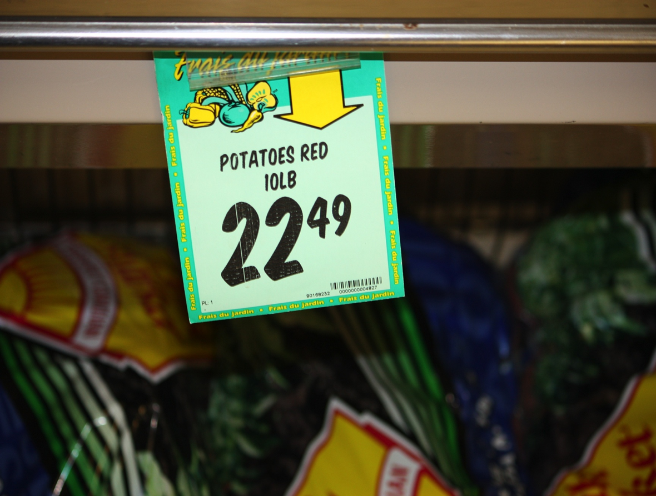
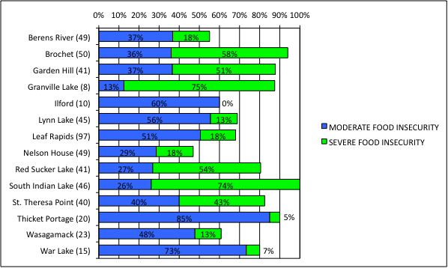
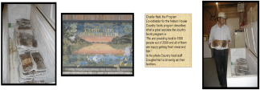
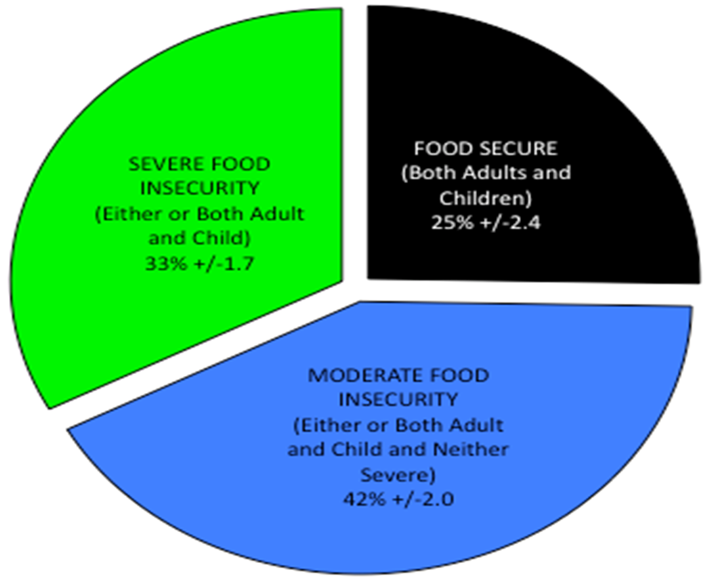
Household Food Insecurity Rates in Northern Manitoba
FLY-IN COMMUNITY
TRAIN ONLY – NO ROAD
Source: Thompson et al., 2012
79% food insecurity in communities with no roads (fly-in and train) and 70% in non-remote communities

Slide 5
Food Security is possible.
Predictive model of food security implementing different
combinations of country foods program, roads and public transit.
Source: Thompson et al, 2012.

Slide 6
Gardening and country foods impact on food security
Amount of food from garden
Food security rates
Source: Thompson et al, 2012

Slide 7
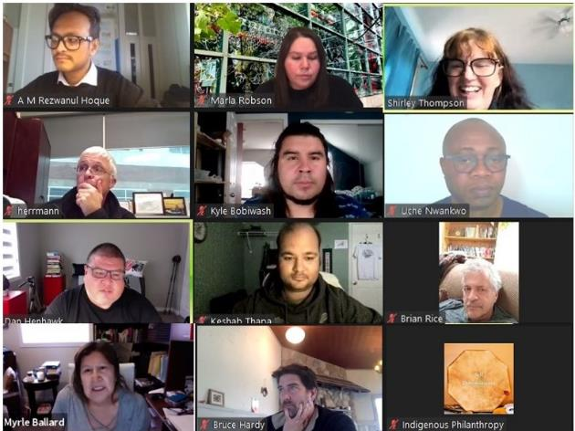
Indigenous Food Systems Team
- met regularly summer and fall to plan Kitigay
- great experts problem-solved to find a pathway

Slide 8
The Stone Soup of Kitigay
Kitigay education program
Engineering Access, Wawatay & Indigenous student centre programs
School of Agriculture diploma program
Courses and administration
Mino Bimaadiziwin Partnership
Brokenhead Ojibway Nation
Courses by
Kyle Bobiwash
Dan Henhawk
Brian Rice
(REC3770, REC2130, AGRI2300)
Myera Inc.
6 Faculties
-Agricultural and Food Sciences,
Kinesiology and Recreation Management,
- CHREER,
- Science
-Engineering
- Architecture
Notes:
The story of stone soup. Someone from the community was hungry and asked for food and got none – because everyone had run out of food. Then she said well let me make you a soup then. All I need is some onions. I’ll make enough for the whole community and you too – all I need is some onions. Then she boiled water with a stone in it and added the onions and tasted and said that all I need moose and one person had one last piece of moose and provided it and another had a wee big of onions –everyone had something to give and the stone (idea of sharing) provided enough food for all
This is really a story of stone soup as when asked all the outside funders that provide a few thousand dollars each year said we do not fund hunting and fishing activities or that any activity should provide a market/economic activity to be funded - -the community found a building and then refurbished and brought it up to Manitoba public health standards for a commercial kitchen got new freezers donated from community health complex, university at a time that I was totally out of funding and it was literally my last block of funding. The school applied with people requiring 55 credit hours
People provided a building,
HR – human resources

Slide 9
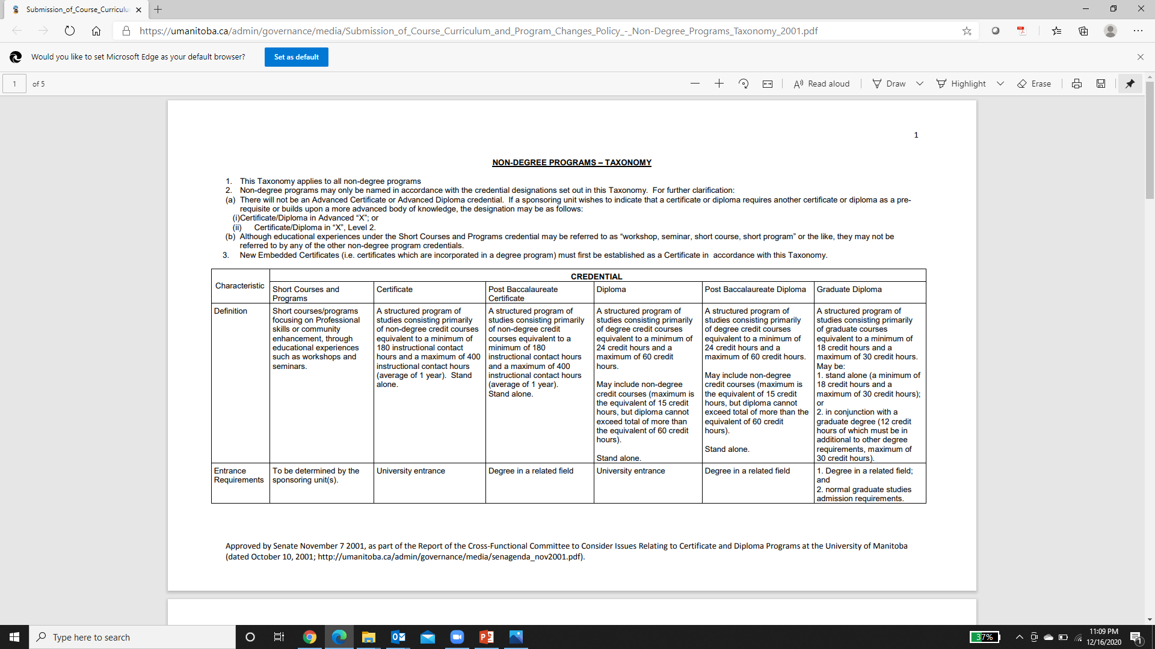
Faculty of Agricultural and Food Sciences with other faculties sponsorship. Successful students to receive a UM letter of accomplishment for 3 to 6 courses & Internship.
After piloting & approval of senate
NOTE: After several years (3 to 5 years) of continuous improvement through piloting these series of course offerings, a diploma and micro-credential in Indigenous Food Systems is expected to be approved by UM Senate as courses are at the diploma and degree levels.

Slide 10
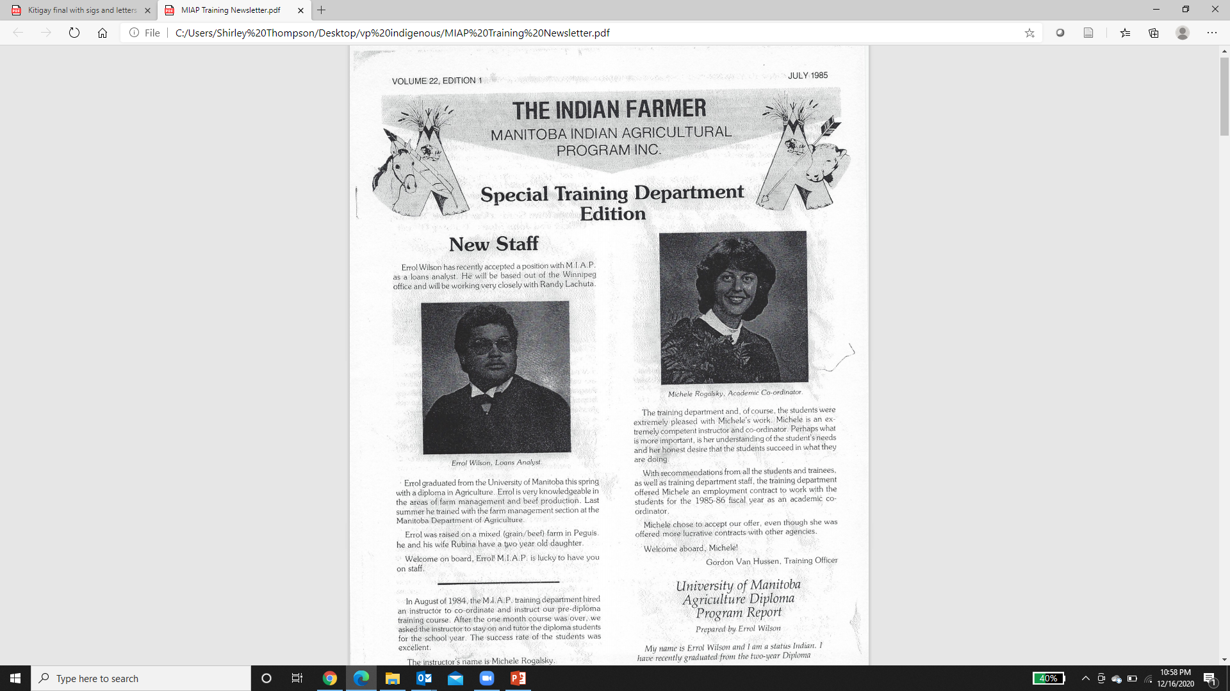

Slide 11
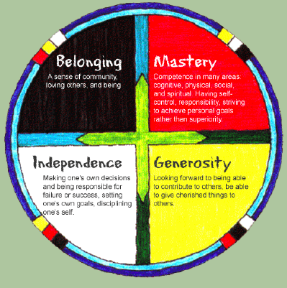
Degree & Diploma courses with
Indigenous content
The Manitoba Indian Agriculture Program (MIAP) engagement with the UM Agriculture diploma in the 1980s provided lessons.
Kitigay will be innovative by including substantive Indigenous content, rather than only including Indigenous students in existing programs. The needs of the Indigenous communities, students, and business partners will be considered in the Kitigay curriculum process, building on existing courses of Indigenous faculty (REC3770, REC2130, AGRI2300) and other courses. Existing distance/blended UM courses, with some inclusion of Indigenous material, will be offered in 2021/22 with the Faculty of Agricultural and Food Sciences sponsorship (UM Senate, 2001).
These existing diploma and degree courses will be developed collaboratively with faculties allowing them to be converted to virtual and blended short course offerings for the 2021/22 term for the first time.

Slide 12
Distance and Blended UM Courses
Kitigay’s distance and blended learning UM courses will provide safety from COVID-19, considering safety as the priority in the start date of a one year program with three pilot cohorts from 2021/22 to 2023/24. Distance education is defined as:
"Formal learning activity where students and instructors are separated by geography, time, or both for the majority of the instructional period." (NRS, 2018, p. 48).
Distance education will mainly be on-demand asynchronous learning through UMLearn media of videos and email, with some synchronous learning opportunities.
Projects-based courses and blended learning will add to distance education through "in-class activities," whether that class be outside at the farm or in the boreal forest undertaking traditional food activities.

Slide 13

Kitigay process
Indigenous community team
leading education & project planning with partners assisting through
financial & research protocols established with
community & UM
Postsecondary
students in
Indigenous communities learn food skills and knowledge through courses &
community
projects assisted by
Post secondary
instructors, partners
& apprenticeships/
practicums
Elders, media,
articles, video,
presentations
mobilize and transmit knowledge to make waves of change in policy, First Nations
and other
communities
Assess educational
& community development outcomes and the role for partnerships assisting through
designs, education, advocacy and research.

Slide 14
Menu of Course Options
The Indigenous food systems curriculum will focus on 2 types of courses:
Courses focused on theory and practice will provide a menu of course options. These UM courses include: AGRI 2300, DAGR 0540, DAGR 0910, REC 2130, REC 3770.
The 2021/22 offering of DAGR 0540 and 9190 would be in Winter 2022. With the support of the Director of the School of Agriculture Michele Rogalsky, some instructors of other courses have committed to incorporate Indigenous materials and knowledge into their program. FAFS has several courses that could be considered for inclusion for a proposed diploma or micro credential in Indigenous Food Systems (i.e., HNSC 1000, HNSC 1200, HNSC 1210, ABIZ 1000, ABIZ 3630, ABIZ 2610, AGRI 3030, AGRI 2620).
The final course options will be determined through on-going dialogue and review with BON and other First Nation and Metis communities and Indigenous students to allow continuous improvement.

Slide 15
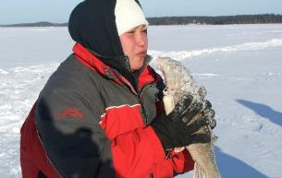
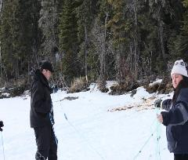
REC 3770: Indigenous Perspectives on Land-Based Education
This course provides an introduction, overview and exploration of Indigenous knowledge systems and ways of knowing as an entry point to understanding Indigenous land-based education on Turtle Island (North America). Treaties, stories, traditional ecological knowledge and ways of living as well as an intensive land-based experiential learning weekend will be used to explore historical and contemporary Indigenous perspectives of the land and land-based education. Prerequisite: REC 2130 (C) or permission of instructor.
DR. BRIAN RICE

Slide 16
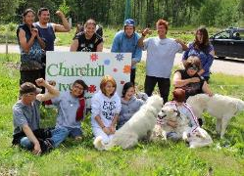
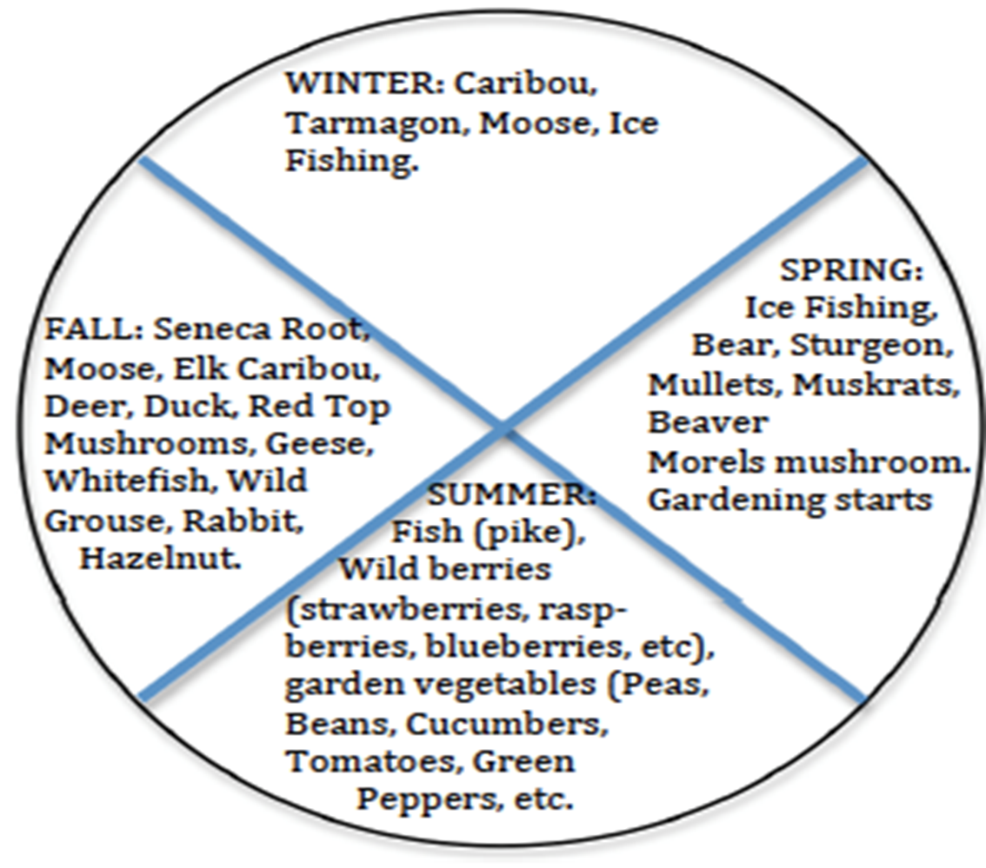
REC 2130 - Introduction to
Outdoor & Land-Based Recreation
This course provides an introduction to both Indigenous and non-Indigenous perspectives on land-based education and outdoor recreation. Students examine how as individuals and groups we can build strong relationships and a robust sense of connection with others, with the land, the outdoors, and with recreation through academic and experiential explorations. Prerequisite: KPER 1400 or permission of instructor.
DR. DAN HENHAWK

Slide 17
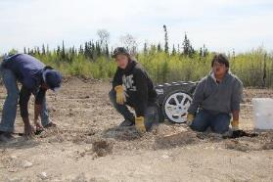
AGRI 2300 –
Indigenous Issues in Food Systems
This course provides an introduction to both Indigenous and non-Indigenous perspectives on land-based education and outdoor recreation. Students examine how as individuals and groups we can build strong relationships and a robust sense of connection with others, with the land, the outdoors, and with recreation through academic and experiential explorations. Prerequisite: KPER 1400 or permission of instructor.
DR. KYLE BOBIWASH

Slide 18
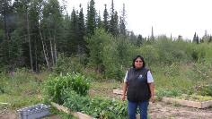
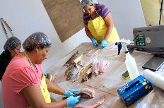
DAGR 09190: Sustainable Agri-food Systems
Distance education offering for Kitigay
Course Calendar Description-
The agri-food system encompasses how food is being produced, processed, transported, marketed and consumed. The three pillars of sustainability (economic, social and environmental) will be used to evaluate and improve agricultural sustainability, and will also be applied to the agri-food system (beyond production). Sustainable solutions are unique to each agricultural situation and require long-term thinking and evidence-based decision-making. Focus will be on the balance between food production practices and protecting the natural resources on which agriculture is reliant.
Instructor Name: Maggie Abwao

Slide 19
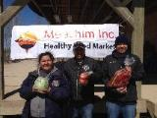
DAGR 0540 Exploring New Opportunities in Adding On-Farm Value
Course Calendar Description-
A practical study of the opportunities for farm operators to increase value return for farm products with innovative approaches to production, processing and marketing. Students will learn from case studies the challenges and realities of value chain integration. Students will develop their ability to critically evaluate business plans for farm product enterprises. Prerequisites: DAGR 0480 and ABIZ 0460 Co-requisites: DAGR 0490 and ABIZ 0470 or permission of instructor – Phil Velhius.

Slide 20

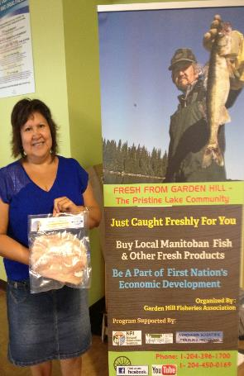
Other: SCI courses TBA
& Elder/ Access Supports
The Indigenous students in the Kitigay courses will benefit from university services, including access to Elders, the community of UM students, UM relational programming and UM access programs. Regarding the UM access program, Herrmann offered online access programming in Engineering for upgrading math and science levels if space is available. The interactions with Indigenous communities and students in Kitigay should be an effective means to recruit students to the UM into other degree and diploma programs.

Slide 21
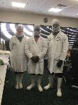
Community-based Internships
2. Project-based courses/internships with Metis and First Nation communities and Indigenous businesses and organizations.
Dr. Thompson has organized a two-week International Permaculture Design Certificate course for the Boreal and Prairie ecosystems at Brokenhead Ojibway Nation (BON) for 2021. This program successfully trained First Nation community members alongside graduate students in 2017 with Four Arrows Regional Health Authority. Graduate and entry-level students will work together to research appropriate Indigenous food systems, with BON Elders to develop designs for building their farmland into a sustainable food landscape, considering climate-smart agriculture.
This course will be jointly taken with ten graduate students to work alongside local BON members to design the farm based on community wishes and traditional ecological knowledge. Also, the Architecture design studio in fall//winter will provide many learning opportunities.

Slide 22
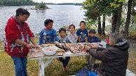
Kitigay’s Indigenous Learning
Kitigay programming will apply the 5 beneficial practices recognized by the 2014 First Nations, Inuit and Metis Essential Skills Inventory Project, namely:
working with/in the community;
learner-centred, holistic approaches;
Indigenous learning principles;
employer involvement in providing work experience; and
control and ownership (Canadian Career Development Foundation, 2014).
Three factors, key to Indigenous self-determination, will be prioritized in Kitigay education and research, namely:
cultural identity;
culturally-appropriate sustainable livelihoods; and
sovereignty (Hibbard and Adkins, 2013).
Indigenous language, respect, caring, and holism are integral to Indigenous knowledge systems (Ballard, 2012; Flavier, 1995; Warren, 1991). We will work with local Indigenous people to learn from local food projects and undertake community harvesting and stewardship activities for medicines, animals, and fish to allow applied training.

Slide 23
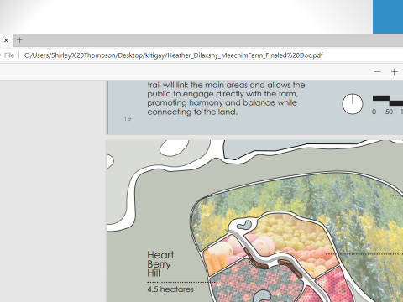
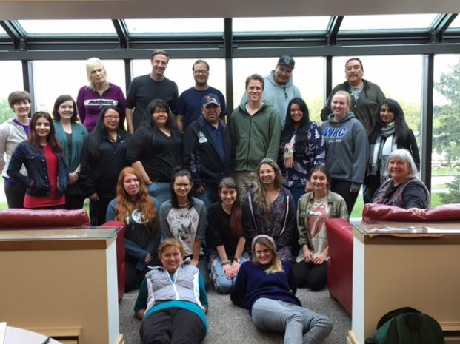
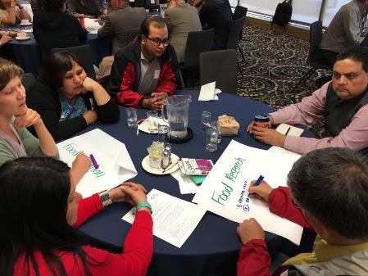
International Permaculture Design graduate course Held in 2017 & to be held again 2021

Slide 24
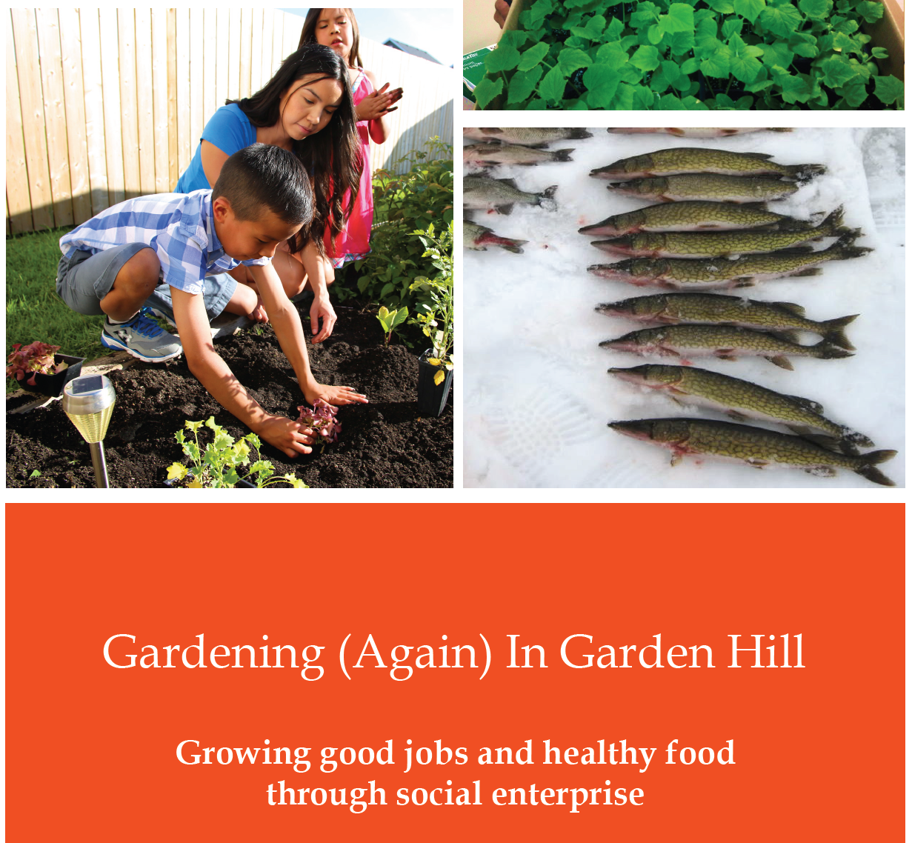

Slide 25

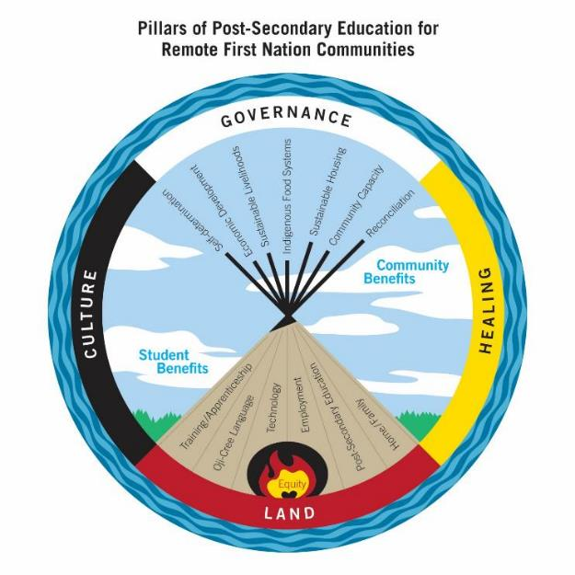
$1 million of talent grant remaining with 50 to 70% to be spent on entry level & undergraduate students. And 30-40% to be spent on graduate students

Slide 26
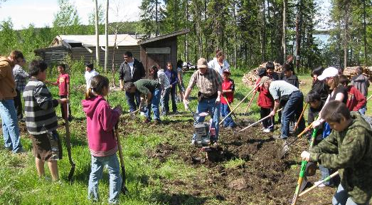
Indigenous Initiative Proposed funding for:
Develop Indigenous learning resources (culturally appropriate videos, workbooks, UMLearn distance/blended courses) across a diversity of courses to offer curriculum choices for Indigenous students and communities,
Pay for course administration during the pilot period for setting up students at the UM,
Cover expenses of UMLearn orientation,
Maximize Knowledge Keepers engagement in courses and internships,
Develop a marketing strategy with employment training and education departments in First Nations, tribal councils and Manitoba First Nations Education Resource Centre.

