Slide 1
Housing, Water and Sewer in Garden Hill First Nation
Lakeisha Barkman,
Elsie Monias &
Shirley Thompson
2018

Slide 2
Introduction
This presentation is the analysis of Garden Hill First Nation (GHFN) Housing and Employment Data from summer of 2017.
Survey organized, written & data collected by GHFN employment authority’s Lakeisha Barkman and Elsie Monias, Director of Employment and Training.
Statistics analyzed by Rezwanul Hoque, Keshab Thapa and Shirley Thompson with Microsoft Excel 2017.
Total Number of Household Respondents is 384 (n=384).

Slide 3


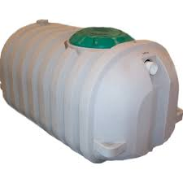


Slide 4



Slide 6



Slide 9
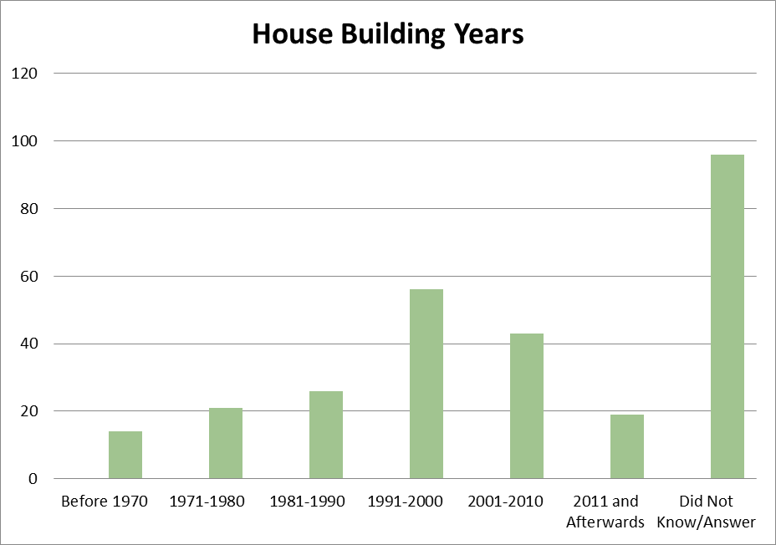
House Construction Year In GHFN
N=275

Slide 10
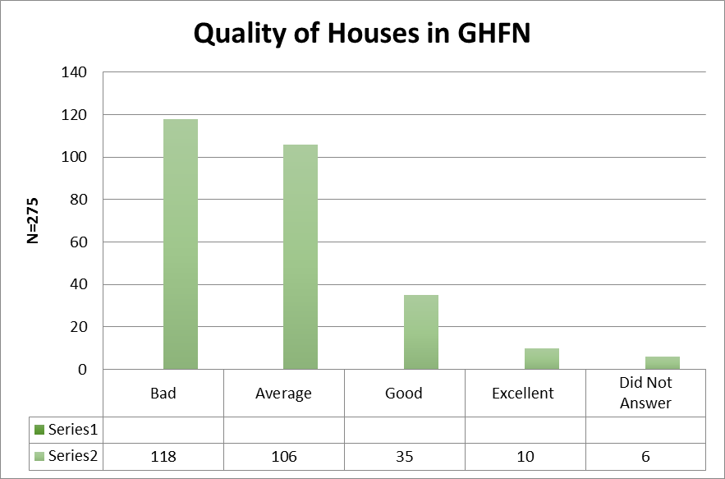
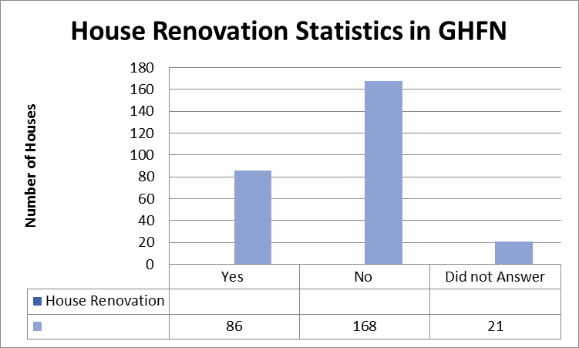
Condition of Houses in GHFN
N=275

Slide 11
Young Adult Employment Status in Garden Hill First Nation age= 15 to 30

Slide 12
High Unemployment –
highest for young adults
Age Group | Unemployment Rate | Employment Rate
Young Adults (age:15-30) | 474 (82% | 105 (18%)
Adults (age:31-64) | 356 (62%) | 221 (38%)
Elders (65+) | 76 (80%) | 19 (20%)
Unemployment rate

Slide 13

How to define home?
NunavutTunngavik defines it for Nunavut as: “a place that provides shelter… a response to special needs, social interaction, comfort and security.”
Qikiqtani Inuit Association: “ a place where someone feels they belong, but its geography is not always fixed in time or space – it can expand, contract, move and change shape according to cultural and personal experiences. “

Slide 14
Housing problem or housing solution?
  “Housing fits in the middle of everything. It is physical design; it is community economic development; it is social development; it is important to health and educational outcomes; it can be a poverty reduction tool, and it is an investment, a wealth creator and a generator of economic development. It is both an individual and public good” (Myers in HOMEWorks, 2009, p. 05).

Slide 15
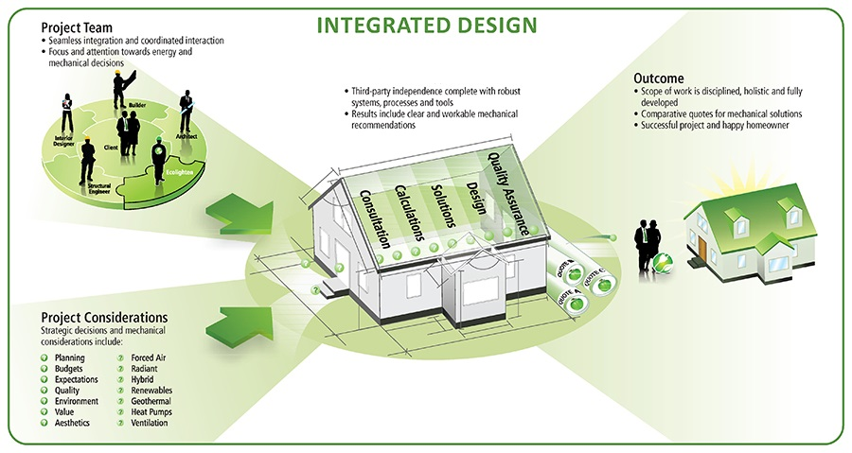


Notes:
Integrated Design is a key component of the Net Zero Energy program and is supported by Gas and Water Utilities. Savings by Design and Save on Energy are two such programs and provide incentives to Developers to assist them in the design process, then pay rebates for exceeding minimum code criteria.

Slide 16
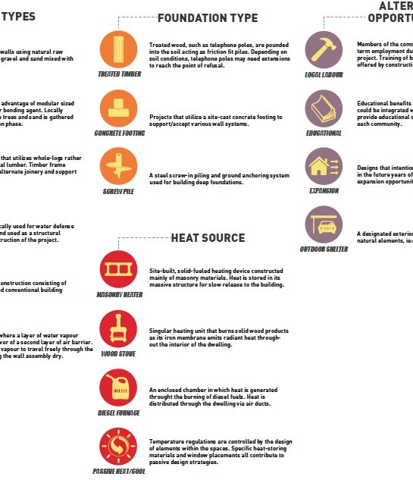
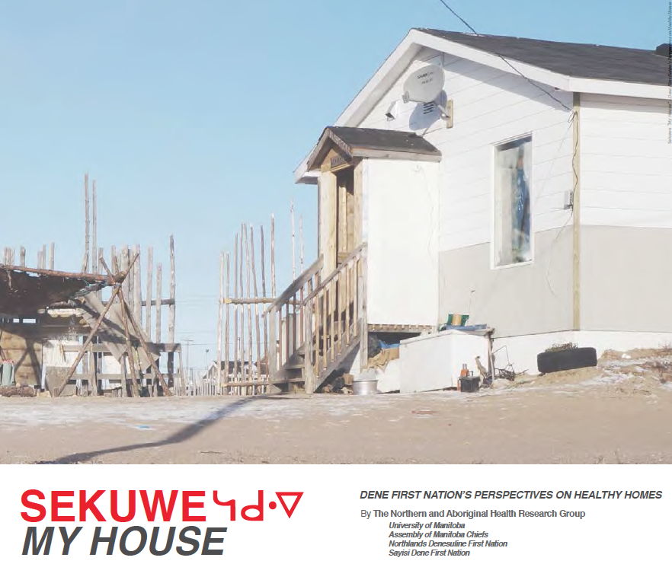
Community Designing: lots to think about

Slide 17
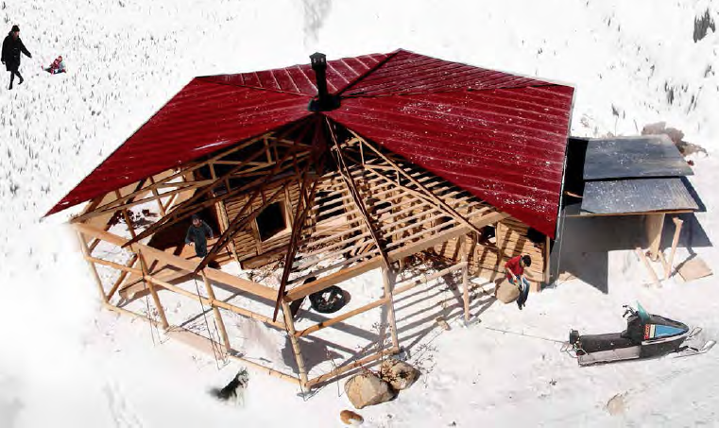

Slide 18
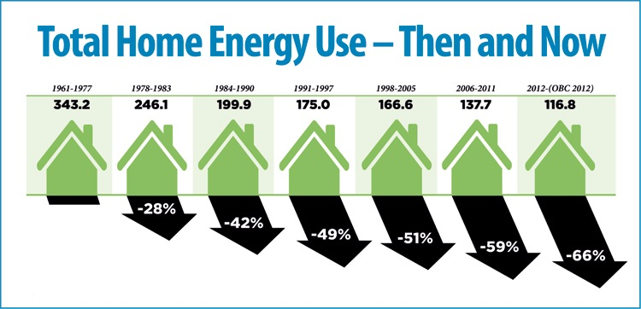
The path of continuous improvement – 1960 to now
The 2017 Code update will see an improvement of 15% over OBC 2012 and forecast the 2022 level
Notes:
Canada has used Building codes to improve the performance of housing since 1960 with performance improvement of over 66% with an additional 15% required as of January 1st 2017. Each code iteration sets the requirement for the next code cycle so that the building community, material suppliers and equipment manufacturers know 5 years in advance where they will need to be on the next code cycle.

Slide 19

Canadian Home Energy Use
Space Heating
Space Heating 60%
Lighting 5%
Space Heating makes up approximately 60 % of the Homes energy load. Forced air furnaces make up the majority of applications with minimum efficiency of 90%
Lighting
Lighting currently makes up approximately 10% of the Home energy use however CFL and LED technology uptake is reducing this.
Air Conditioning
A/C 5%
Although Canada is a heating dominated climate, forced air cooling is common in homes and accounts for approximately 5% of annual energy consumption
Potable Water Heating
Water heating makes up approximately 20% of the Homes energy consumption. Averaging 225L/day, water heating is most often provided by storage type tanks with minimum efficiency of .57 EF
Water Heating 20%
Appliances 10%
Major Appliances
Major Appliances, including refrigerator, dishwasher and laundry account for approximately 10% of household energy use
Notes:
Most of Canada is in a cold climate zone so space heating makes up the largest piece of the energy pie followed closely by water heating. Forced air furnaces are the primary source of heat.

Slide 20




Building Sustainable Path to Healthy Housing
100% better
80% better
50% better
Produces as much energy as it consumes
20% better
Ground zero
Net Zero Ready
Building Code
Energy Star
R-2000
2006 Provincial Building Code is the baseline for comparison. As Code improves, so does the baseline
Benchmarked against the Building Code, an Energy Star Home is approximately 20% more energy efficient
An R-2000 Home is approximately 50% more energy efficient than a code built home
The Net Zero Ready Home is approximately 80% more energy efficient with additional features to allow for installation of solar thermal and PV.
Notes:
The Canadian Home Builders Association actively promotes and supports the voluntary labeling systems approach and has worked with the Federal Government to establish the Net Zero Energy Housing Council to work towards a Net Zero by 2030 program.

Slide 21


Slide 22
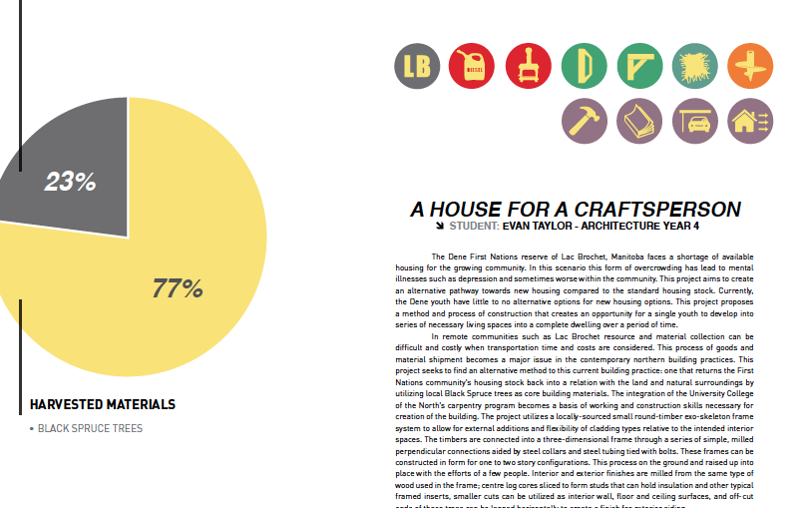
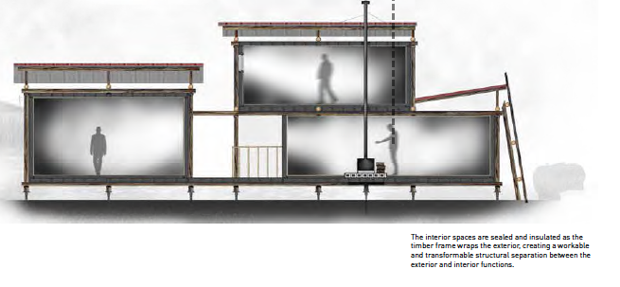

Slide 23
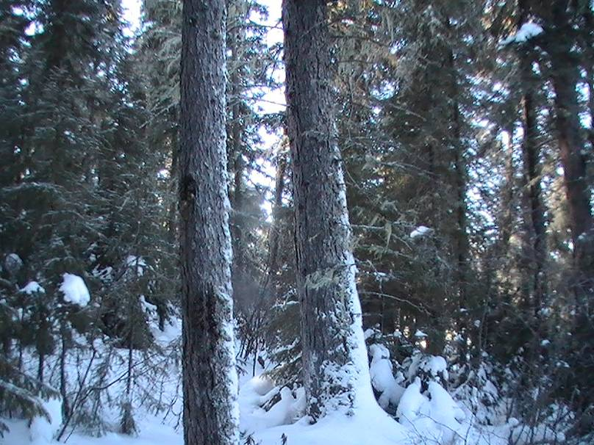
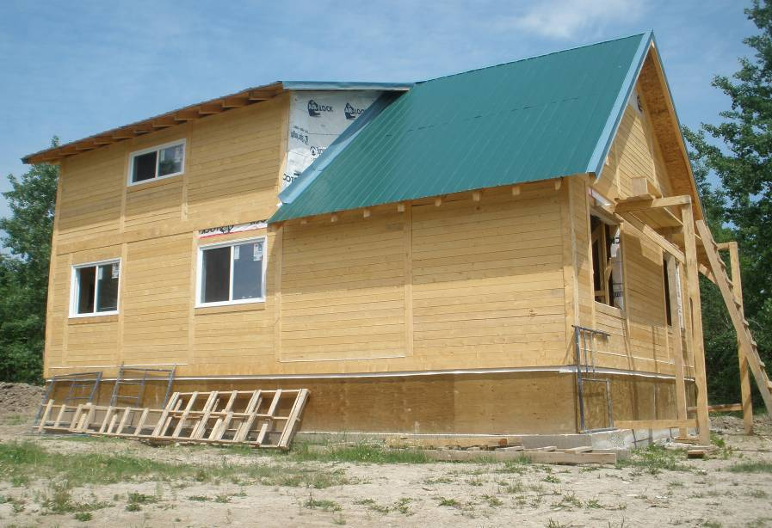
Standing Tree to Standing Home.
Course: Home Builders Program
60 Trees
= 1 House
Notes:
Trees -- big trees in the island lake area.
Medium trees may take more.
That house is in Garden Hill.

Slide 24
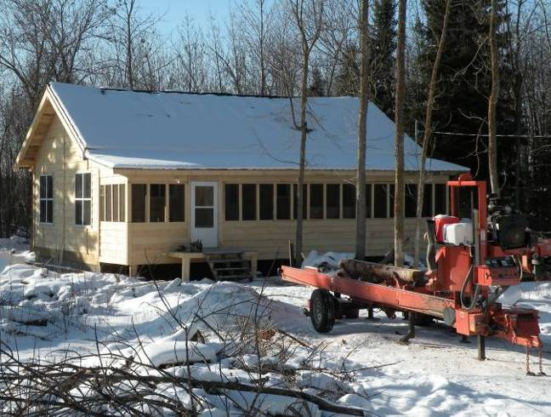
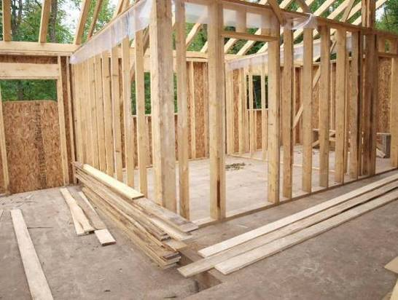
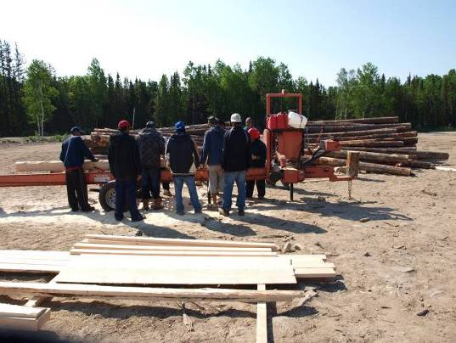
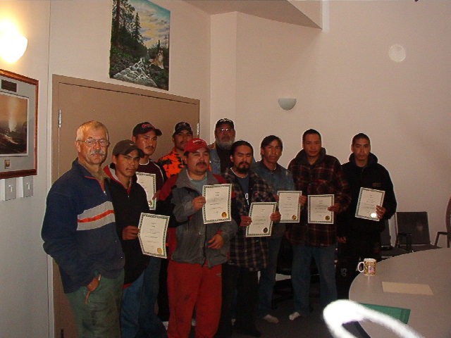

Standing Tree to Standing Home
Notes:
Log cabin course is a 12 day course and have built log homes in garden hill.
Walter Keller is the log builder but have to get instructors for pieces of this. Reput the curriculum again.
Lots of guys can teach chain saw and wood meiser.

Slide 25
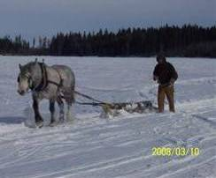
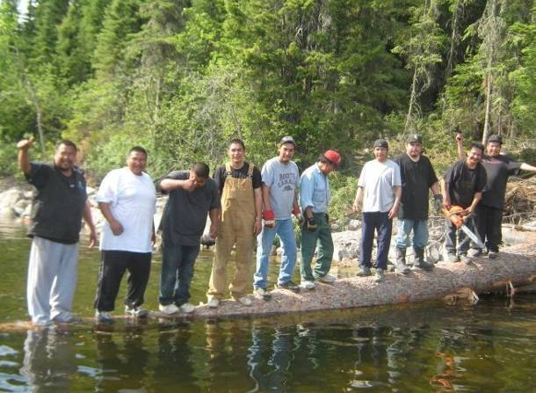
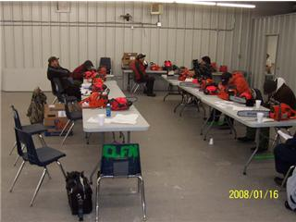
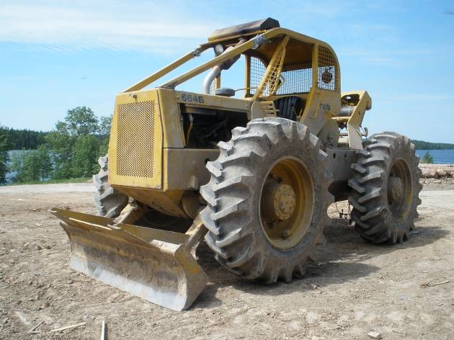
Forestry
Notes:
Standing tree – harvest in winter and sawmill in spring.
Big red building – to store wood inside.
Forestry course – biggest challenge is getting the wood out.
Garden Hill guys floated the trees out.
Or skidder.
Can take the woodmeiser to bush and haul out by truck.
S

Slide 26
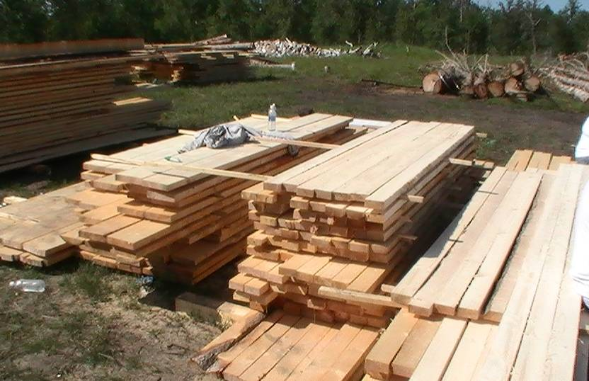
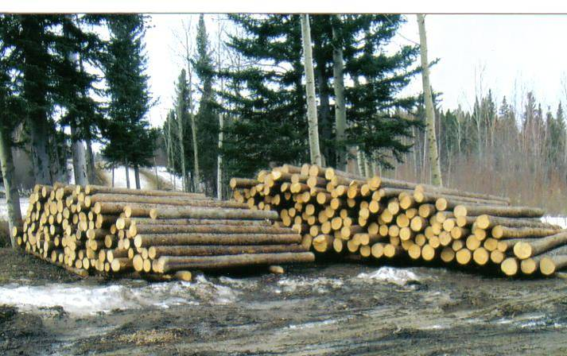
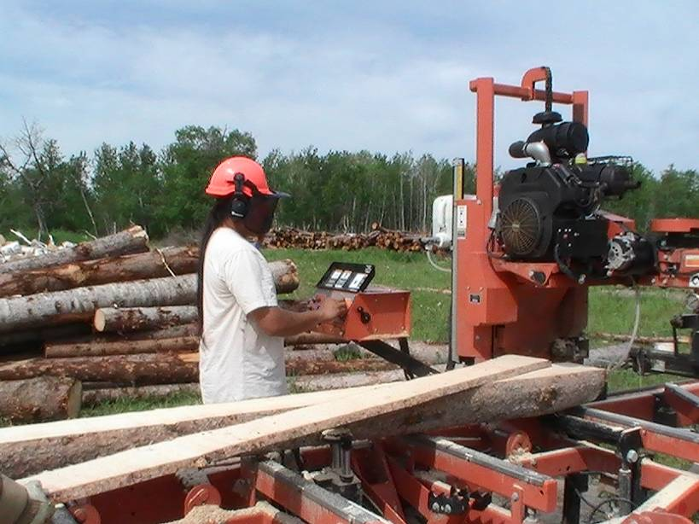

Milling
Notes:
Woodmeiser sawmill –same as in Garden Hill and Was..
Pile of logs, nice lumber.
Island Lake Stamp – or grade stamp of lumber.

Slide 27
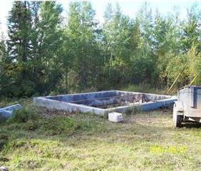
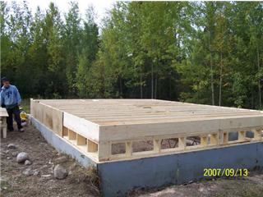
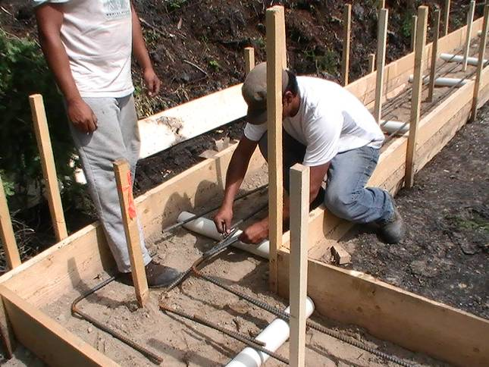
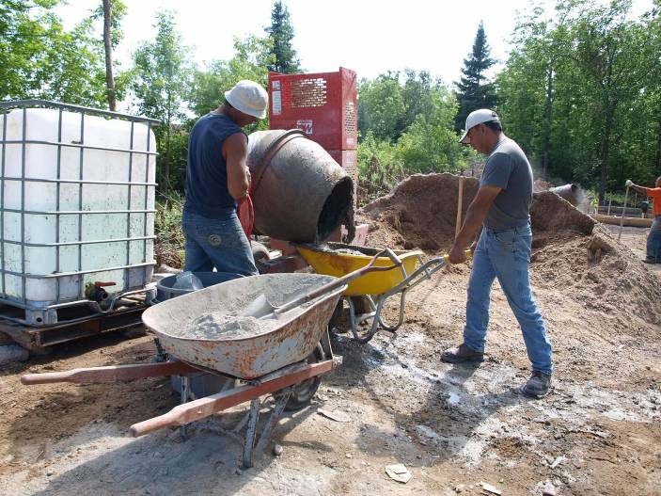
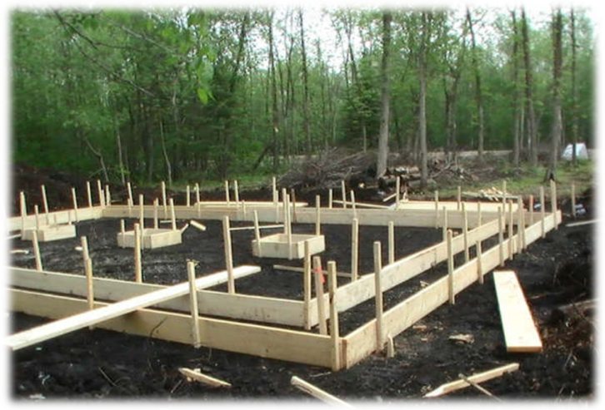
Foundations
Notes:
Used a used foundation.
Foundation had a house fire on top of it.
Built on top of it.
Pony wall to create

Slide 28
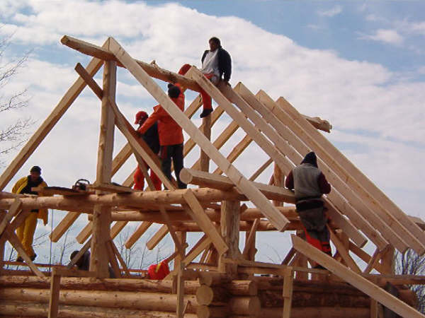
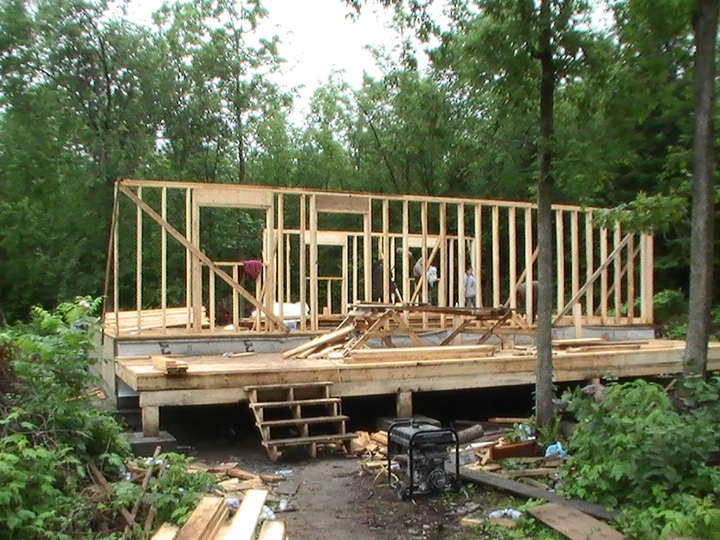
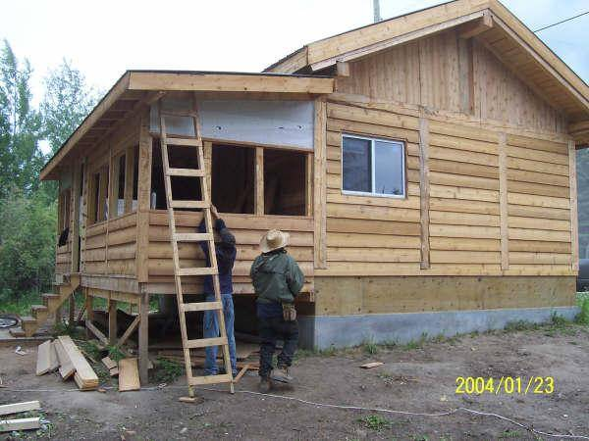
Framing
LOG
Stick Wall
Timber Frame
Notes:
Top one is log frame.
Timber frame in south indian
3rd is stick wall in Sagkeeng.
Get logs you can do those three things in it.
Finishing is showing the

Slide 29
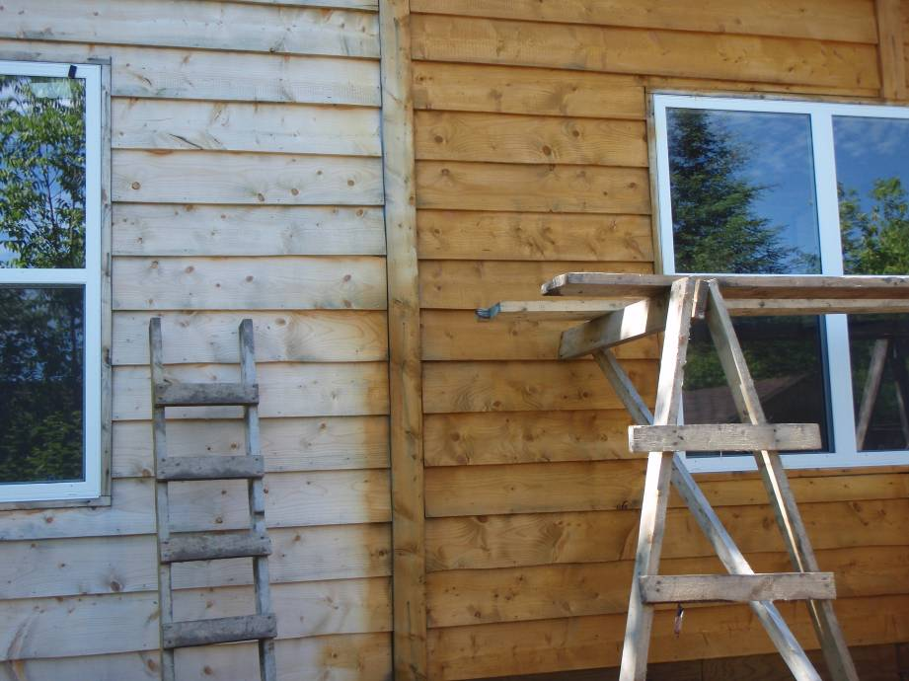
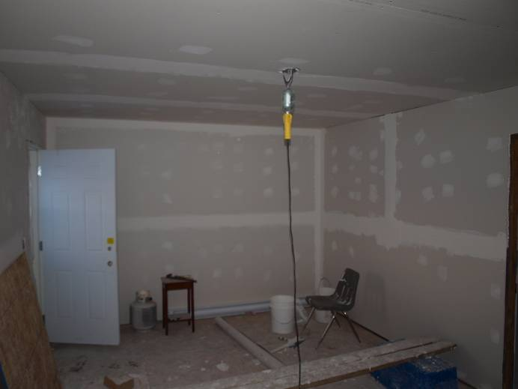
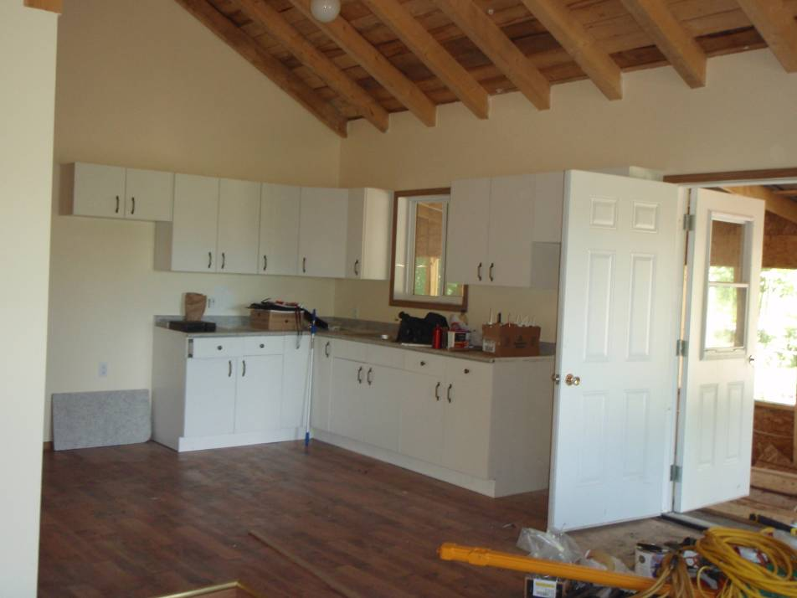
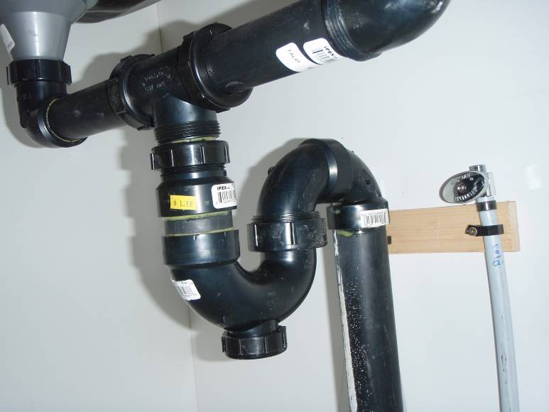
Finishing
Notes:
Finishing showing the staining, plumbing and eletrical

Slide 30
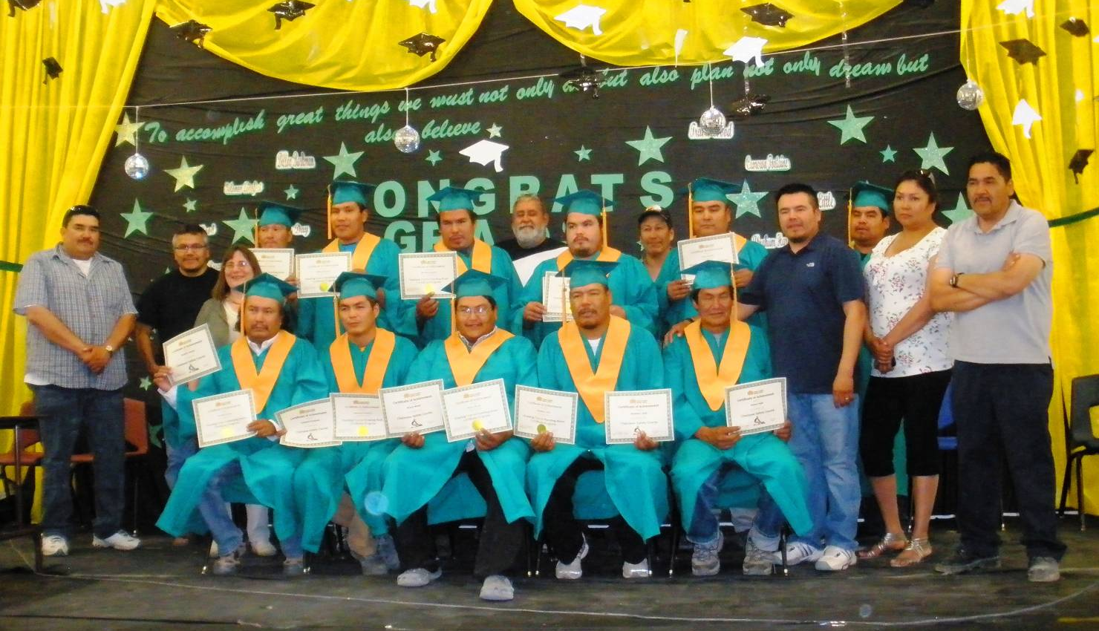
Garden Hill, July 5, 2011
Notes:
Garden hill FN.
33 started.
It takes a year to build the house at least.
They have a zero tolerance policy for alcohol – will get kicked out if caught drinking. Lost some really good people. That is their local policy and they are in a training program.
That will influence the outcomes for people you employ and for people in training.
Gowns and feasts for graduation.
Huge accomplishment -18 months.

Slide 31
Finishing Cost
Finishing Costs for 2-Bedroom House
Foundation | $15,000.00
Sheathing | 500.00
Roofing | 3000.00
Windows (1 Big and 6 Small) | 4000.00
Doors (2 Exterior & 6 Interior) | 2500.00
Insulation and Poly | 2000.00
Drywall, Mud, Primer, Paint | 2000.00
Electrical | 5000.00
Plumbing: Sewer/Water Tanks | 5500.00
Plumbing: Piping & Fixtures | 2000.00
Flooring | 1500.00
Kitchen Cabinets | 3000.00
Miscellaneous items | 2000.00
TOTAL | $48,000.00
Notes:
Older – recosted it for 2 bedroom for a single mum or bachelor pad.
In 2013 – under $60,000 but need to add on the freight.

Slide 32
Want to know more ?
Natural Resources Canada - www.nrcan.gc.ca/energy/efficiency/housing
Canadian Homebuilders Association - www.chba.ca/
Net Zero Energy Housing Council - http://www.chba.ca/members-area/committees-councils/net-zero-energy-housing-council.aspx
Net Zero Pilot Project-
Builder Videos www.vimeo.com/buildability

