Slide 1
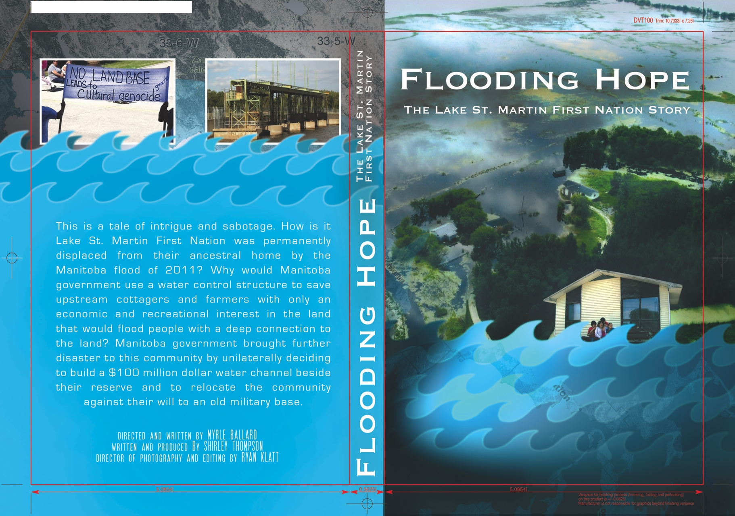
Flooding of First Nations & Environmental Justice in Manitoba
Shirley Thompson

Slide 2
Who is permanently displaced by flooding in Manitoba?
2011 “Super” Man-made Flood
Lake St. Martin FN,
Little Saskatchewan FN (more than half of community).
Hydro Development in Manitoba
O-Pipon-Na-Piwin Cree Nation (OPCN),
Chemawawin Cree FN
.

Slide 3
Who is permanently displaced by flooding in Manitoba?
2011 “Super” Man-made Flood
Lake St. Martin FN,
Little Saskatchewan FN (more than half of community).
Hydro Development in Manitoba
O-Pipon-Na-Piwin Cree Nation (OPCN),
Chemawawin Cree FN
. ONLY First Nations.

Slide 4
Who is permanently displaced by flooding in Manitoba?
2011 “Super” Man-made Flood
Lake St. Martin FN,
Little Saskatchewan FN (more than half of community).
Hydro Development in Manitoba
O-Pipon-Na-Piwin Cree Nation (OPCN),
Chemawawin Cree FN
. ONLY First Nations. No non-First Nations

Slide 5
http://www.youtube.com/watch?v=b6tVbSSRSbI&feature=youtu.be

Slide 6

Flooding Hope

Slide 7
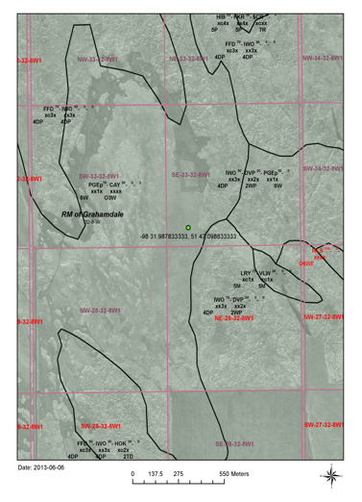
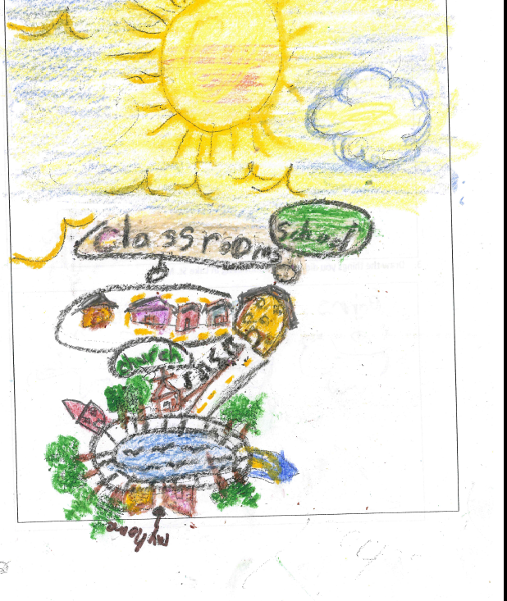
A child’s vision of what Lake St. Martin FN could look like is probably not possible on land government bought without consultation

Slide 8
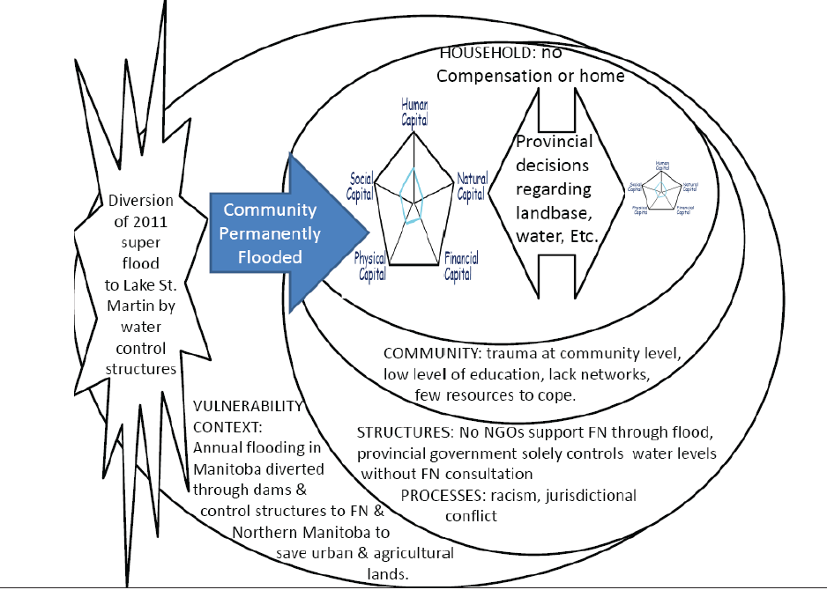
Lake St. Martin First Nation Livelihoods Diminished

Slide 9
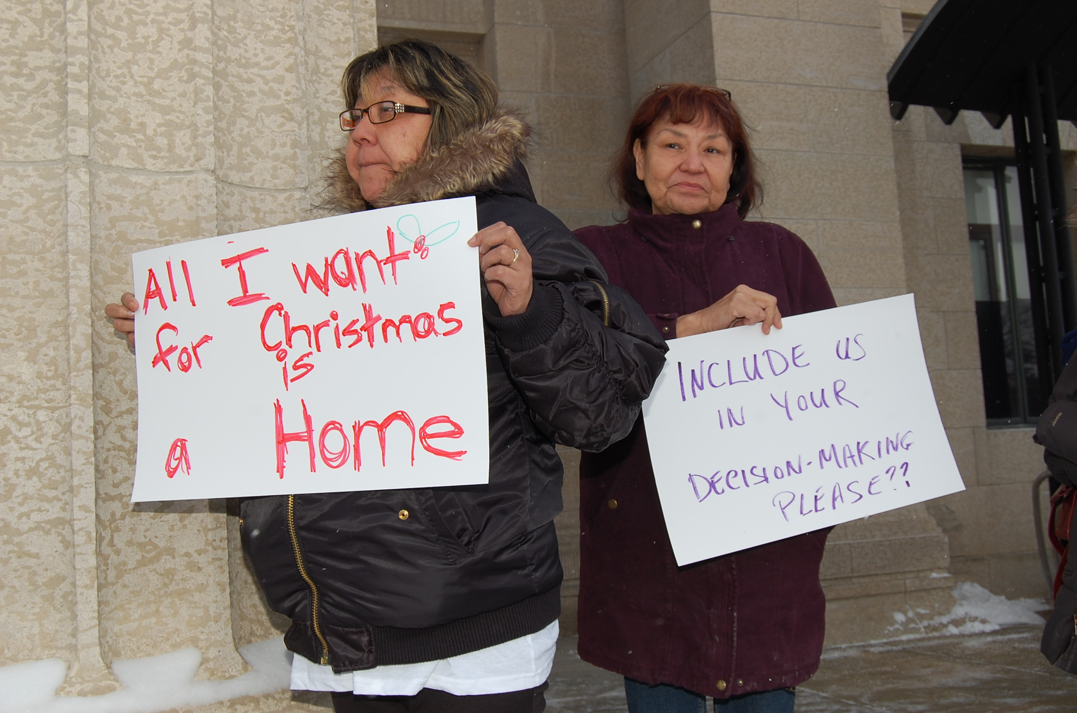
This was the 5th Christmas since the evacuation and the whole community remains homeless
http://www.youtube.com/watch?v=b6tVbSSRSbI&feature=youtu.be

Slide 10
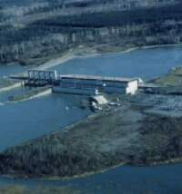
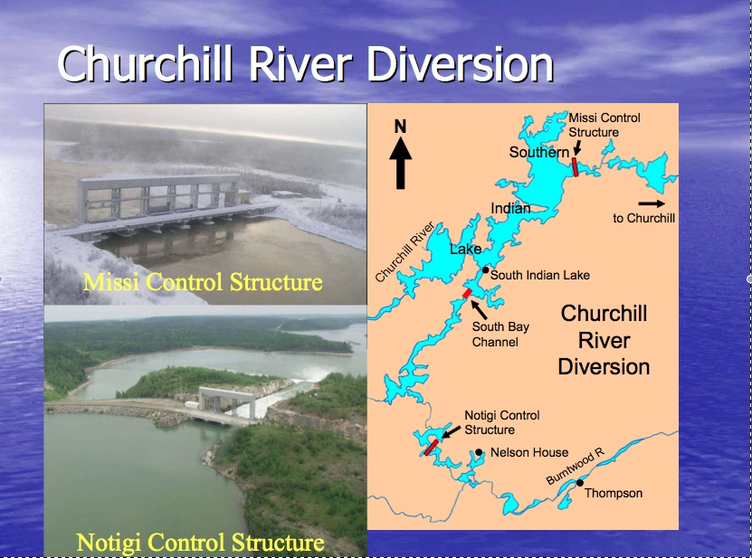
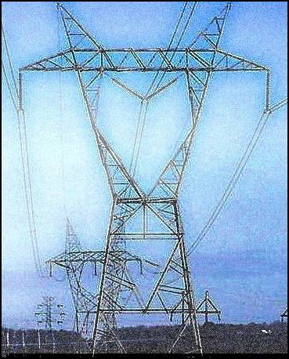
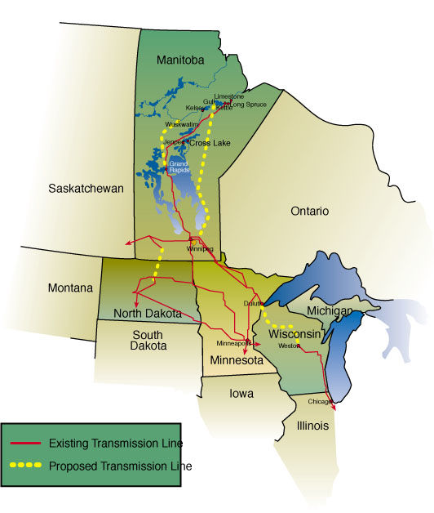
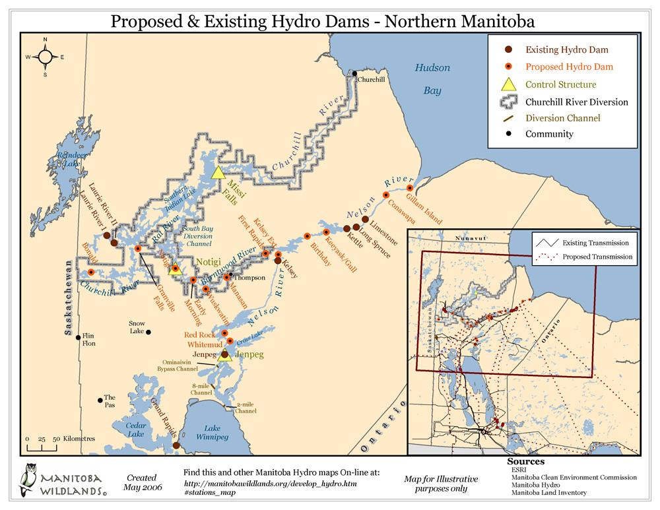
Hydroelectric dams impacting Manitoba First Nation lands & people
Modified from: Grossman, 2012

Slide 11
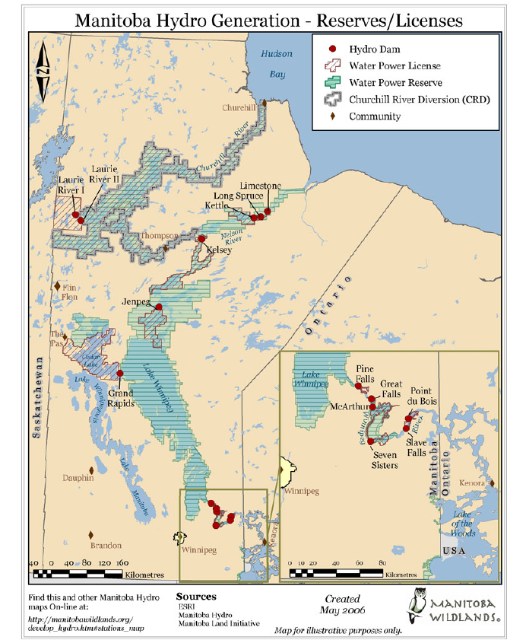
Location of Manitoba Hydro Dams
https://www.youtube.com/watch?v=ph7Kw1LFWS4&feature=youtu.be

Slide 12
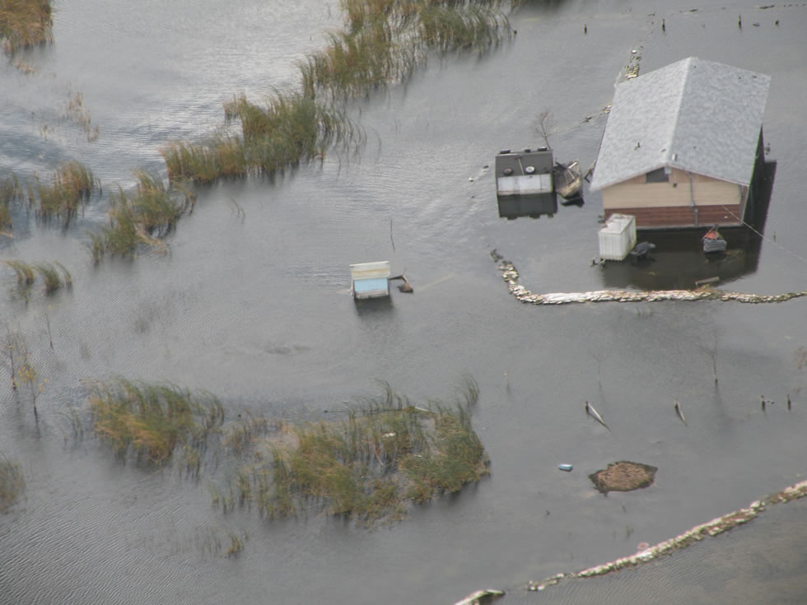
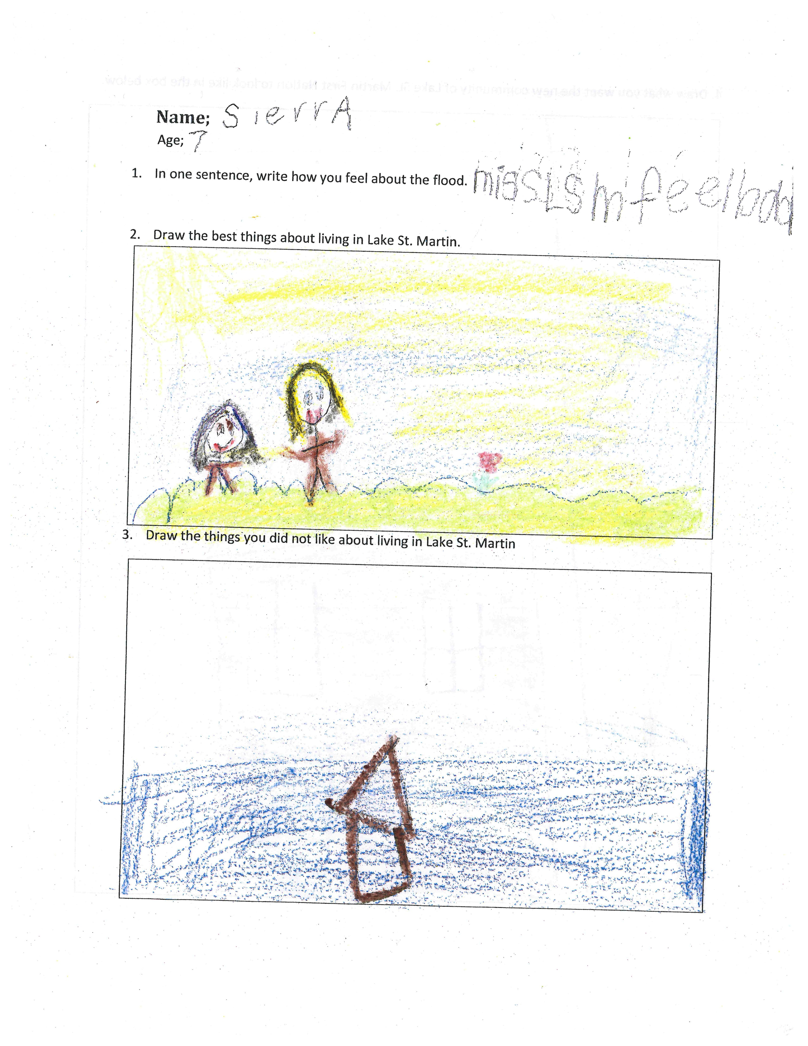
Indigenous Wellbeing
Taylor (2007) and Panelli & Tipa (2009) Indigenous wellbeing revolves around:
Social relationships
Connection to the land
Kinship
Traditional knowledge
Reciprocity
Identity
Accountability
Physical, social, spiritual and emotional wellbeing
But what does this mean for displaced communities?

Slide 13
The Indigenous need for a land Base (Article 10 – UNDriP)
As well, the United Nations Declaration on the Rights of Indigenous Peoples repeats this need for a
land base in Article 10: “Indigenous peoples shall not be forcibly removed from their lands or territories. No relocation shall take place without the free, prior and informed consent of the indigenous peoples concerned and after agreement on just and fair compensation and, where possible, with the option of return” (United Nations 2008:13).

Slide 14
The United Nations Declaration on the Rights of Indigenous Peoples (UNDRIP – s. 26)
1. Indigenous peoples have the right to the lands, territories and resources, which they have traditionally owned, occupied or otherwise used or acquired.
2. Indigenous peoples have the right to own, use, develop and control the lands, territories and resources that they possess by reason of traditional ownership or other traditional occupation or use, as well as those which they have otherwise acquired.
3. States shall give legal recognition and protection to these lands, territories and resources. Such recognition shall be conducted with due respect to the customs, traditions and land tenure systems of the indigenous peoples concerned (United Nations 2008:13).

Slide 15
Why are First Nations more at risk?
1) More historic, ancestral and spiritual ties to traditional territory.
2) Sustenance lifestyle.
3) Economic assets have little collateral, capital or credit – as don’t own land or houses.
4) Infrastructure poverty, with many FNs communities lacking adequate safe housing, piped water/sewage, road access and lacking fire stations, landfills and hospitals, placing people in more unhealthy or risky situations.
5) Reduced human (e.g., low levels of education, low rates of employment and high rates of disease compared to other communities in Canada).

Slide 16
Why Are First Nations more at risk?
6) Isolation of many reserves far away from public and media.
7) Jurisdictional barriers with FN reserves federally managed, without FNs having the regulatory authority or ownership of resources and land/water in their ancestral territory, but with resources, including water, managed provincially.
8) Less political clout resulting in few opportunities for Aboriginal peoples to influence policies, programs, and their own development.
9) Social crisis (e.g., higher rates of addictions and violence), as the aftermath to the residential school system, reserve settlements, and the settler education;
10) Location of reserves by government on poor or swampy lands

Slide 17
Disproportionate Burden
First Nation communities typically do not:
generate problem
receive marginal or no benefits &
bear environmental & social burden

Slide 18
What is Environmental Justice?
Environmental justice is “the fair and consistent distribution of environmental benefits and burden, without discrimination on the basis of socio-economic status, race, ethnic origin, or residence on an Aboriginal reserve” (Venton and Mitchell, nd).

Slide 19
Environmental Injustice
Is NOT only from pollution, resource extraction and flooding but also from not having enough food, housing, safe drinking water, and health services).

Slide 20
What has to happen in Manitoba?Canada? Considering..
City of Flint drinking water (states of emergency)?
Shoal Lake 40?
Truth and Reconciliation Commission of Canada Recommendations?

